Slide 1
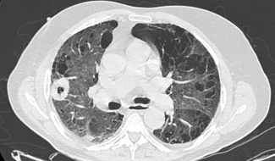
GP access to body CT for suspected malignancy
Pilot audit results
Dr Allan Green/Dr Stephen Glancy, Radiology, NHS Lothian

Slide 2
Referrals
28 referrals
1 patient refused scan; 1 request was actually for CT brain; 1 should have been an Ultrasound
25 CT Chest, Abdomen and Pelvis scans performed
88% (22/25) referrals appropriate for pathway, 12% (3/25) should have been arranged by secondary care.
100% (25/25) appropriate for CT scanning

Slide 3
Referral to Scan
Mean time from referral to scan 21 days
Notes:
Two graphs

Slide 4
Patients
Mean age 70.8
12 Male
13 Female
Notes:
Practice referred total number

Slide 5
Cancer pickup
24% (6/25) definite cancers
2 Lung
2 Pancreas
1 Renal
1 Cervical
5% (1/25) possible cancer
1 Lung

Slide 6
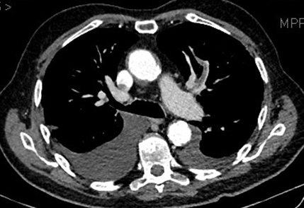
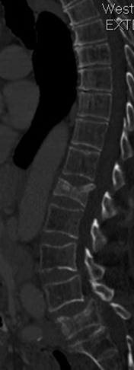
Other findings
Overall (14/28) 50%
1 Renal calculi
1 PE
2 Pneumonia
2 Hydronephrosis
1 Rib fractures
2 Vertebral fractures
1 Cirrhosis
1 Asbestos lung disease
1 Pancreatic cysts
1 Pulmonary nodule
1 Lung scarring

Slide 7
Referral to secondary care
20% (5/25) of patients scanned did not then require a secondary care referral

Slide 8
Further tests
25 Patients scanned
6 Cancer
18 No cancer
13 Referred to secondary care
5 Not referred to secondary care
4 Follow up imaging
9 No follow up imaging
1 probable

Slide 9
Summary
Appropriate referrals
Significant detection rate of cancers
Significant reduction in referral to secondary care
Significant relevant non cancer findings
Education on using appropriate pathways
Potential to significantly streamline the cancer pathway

Slide 10
FAQs
How do I refer a patient for CT with a suspected malignancy?
Refer to Guidance on RefHelp (URL...)
Via SCI Gateway (URL...)
What do I do if the CT I request reveals a malignancy?
Refer as urgent to the appropriate specialty as normal. If the primary source is unclear, refer to the Cancer of Unknown Primary (CUP) Team or contact CUPTeam@nhslothian.scot.nhs.uk to discuss
What do I do if there is an ‘incidental’ finding on the CT?
The report will often guide the referrer as to the most appropriate next step; often no action is required. Specific advice may be available on RefHelp. The reporting radiologist will also be able to advise on specific findings and is happy to be contacted.
Renal or hepatic cysts do not generally merit any follow-up unless advised
Atelectasis, tiny pulmonary nodules, sub-cm nodes, diverticular disease, bony haemangiomas and Tarlov’s cysts are usually incidental findings
How do I contact the reporting radiologist?
NHS email is usually the easiest way to communicate. The duty radiologist in each department will also be available for advice.
What if the patient has a CXR suspicious of malignancy?
These patients should NOT be on the Vague Symptoms Pathway. There is an established Fast Track Suspected Lung Cancer Pathway at WGH (LCCWGH@nhslothian.scot.nhs.uk) , SJH (SJH.Respiratory@nhslothian.scot.nhs.uk ) and RIE (0131 242 1867)
What if I request an US which shows suspected liver metastases, but no obvious primary?
These patients should NOT be on the Vague Symptoms Pathway. Sometimes the Radiology department will arrange further imaging or suggest the appropriate next step. The CUP team are happy to be referred these patients (CUPTeam@nhslothian.scot.nhs.uk).

